Slide 1
ITC forms in GST

Slide 2
FORM ITC 01

Slide 3
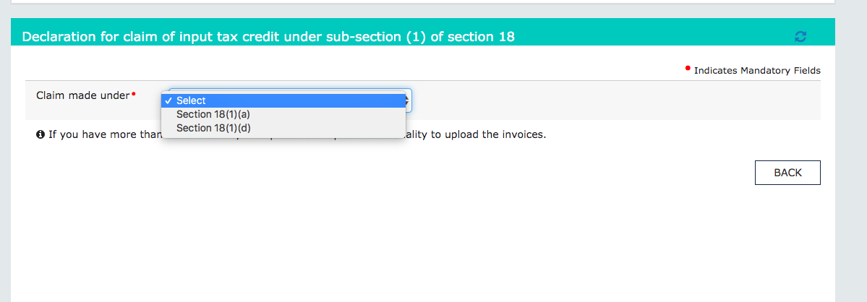
ITC 01: Declaration u/s 18(1)

Slide 4
ITC 01: When to use
Section 18(a): Normal registration: In case of new registration is the taxpayer takes registration within 30 days from the date when he become liable. he will be eligible to take the input tax credit on inputs in stock , in semi finished and finished goods as on the day immediately preceding the day when he become liable for registration.
e.g. XYZ LTD was formed on 31st January 2019. On 20th March 2019 their turnover crossed the threshold limit of Rs. 20 lac. They applied for registration on 30th March and duly granted the registration. They will be eligible to claim the ITC on stock of inputs and inputs contained in stock of semi finished and finished goods as on 19th March 2019. They will be able to avail this ITC by filing ITC 01 on the portal.

Slide 5
ITC 01: When to use
Section 18(b) Voluntary registration: Taxpayers who has taken a voluntary registration u/s 25(2) are also eligible for same ITC on their opening stock of inputs. In this case ITC of date immediately preceding the day when registration was granted will be considered.
Section 18(c) shifting from composition to normal levy: In this case the ITC on stock and capital goods will be available. The day immediately preceding the day when the transfer from composition to normal levy was made, will be relevant.
Section 18(d) Exempt supply become taxable:: In this case where the exempt supply become taxable ITC of stock of inputs and capital goods shall be available. In this case day immediately preceding the date of becoming taxable will be the relevant date for stock.

Slide 6
ITC 01: How to use
Go to GST dashboard and select the forms from ITC forms. Select section which is relevant for filing. It will be any of section 18(1) a,b or d.
Invoice details are required to be filled to claim ITC under this head. Following details will be filled.
GSTIN of supplier.
Invoice number.
Goods type
UQC
quantity
Value
amount of input tax credit
The taxpayer is also required to inform whether the goods are contained in stock of goods or of semi finished or finished goods.
In case of bigger data an offline utility is also available.

Slide 7
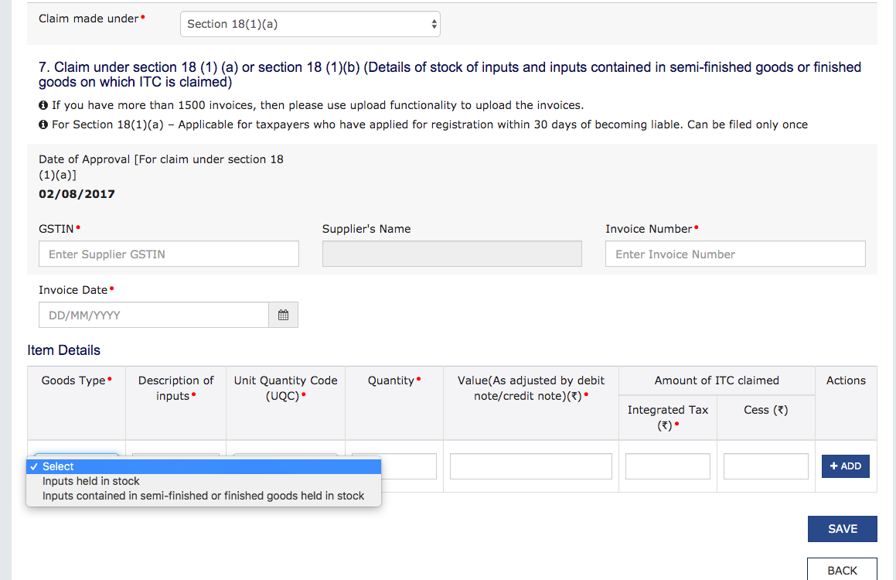
ITC 01: Declaration u/s 18(1)(a&b)

Slide 8
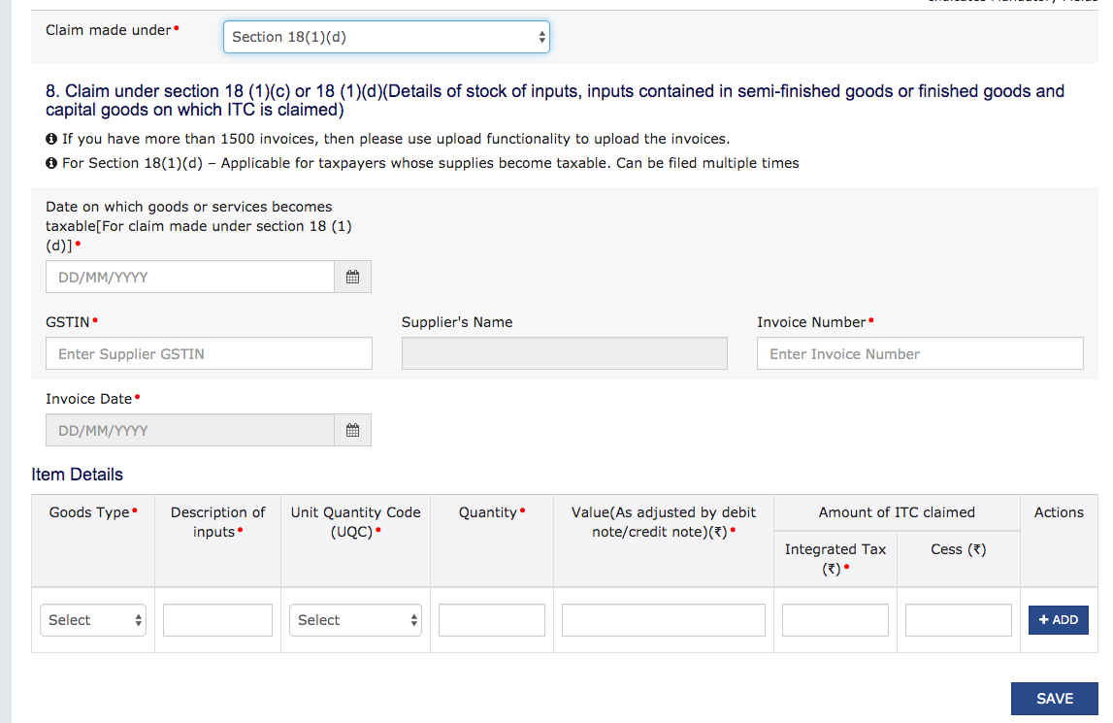
ITC 01: Declaration u/s 18(1)(c & d)

Slide 9
FORM ITC 02

Slide 10
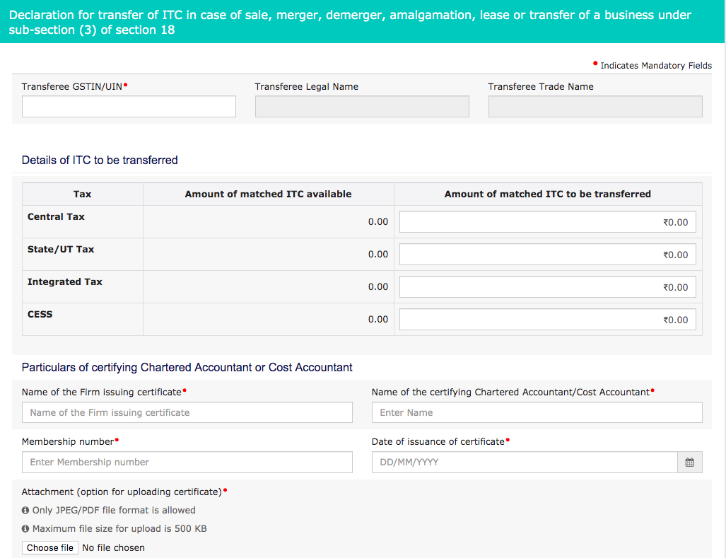
ITC 02: Shifting ITC in case of transfer of business

Slide 11
ITC 02: When to use
Section 18(3)
When there is a change in constitution of a registered person on account of
Sale
merger
demerger
amalgamation
lease or transfer
with specific provision for transfer of liabilities .
The said person shall be allowed to take ITC , which remained unutilised in his electronic credit ledger. This ITC will be shifted to the transferee.

Slide 12
ITC 02: How to use
Go to GST dashboard and select the forms from ITC forms. Select section which is relevant for filing. It will be any of section 18(1) a,b or d.
In this case GSTIN of transferee is required to be filled . ITC ledger will be there. Transferor can choose from the ITC ledger what amount they want to shift.
In this case a certificate from a chartered accountant or a cost accountant will also be required.
This certificate will be uploaded on postal.

Slide 13
FORM ITC 03

Slide 14
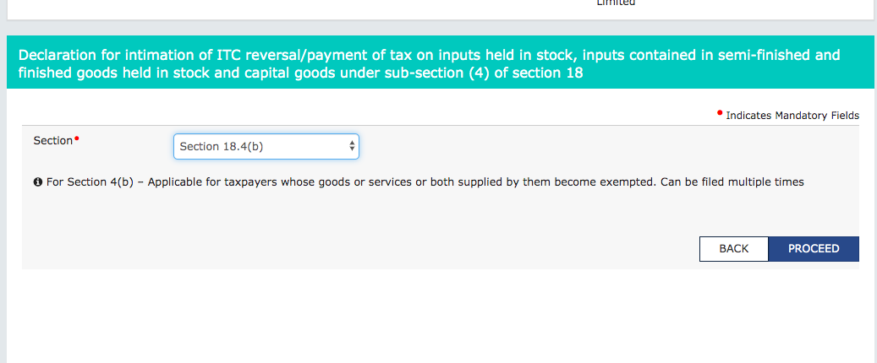
ITC 03:section 18(4) Section 9 to 10 or 11

Slide 15
ITC 03: When to use
ITC 03 will be used for reversal of input tax credit in following two cases:
When a person paying tax under normal levy shift to composition levy.
When a taxable supply becomes exempt.
Taxable person will be liable to pay an amount
equivalent to ITC of inputs and capital goods in stock on the immediately preceding day of shifting.
ITC of capital goods will be reduced by 5% per quarter and then balancing figure will be reversed.

Slide 16
ITC 03: How to use
Details of inputs and capital goods will be feeded into this form.
where invoice is available
where invoice is not available
inputs and capital goods of GST regime
inputs and capital goods of pre GST regime
All of above details will be entered. The amount of relevant ITC will be reduced from the balance.

Slide 17
FORM ITC 04

Slide 18
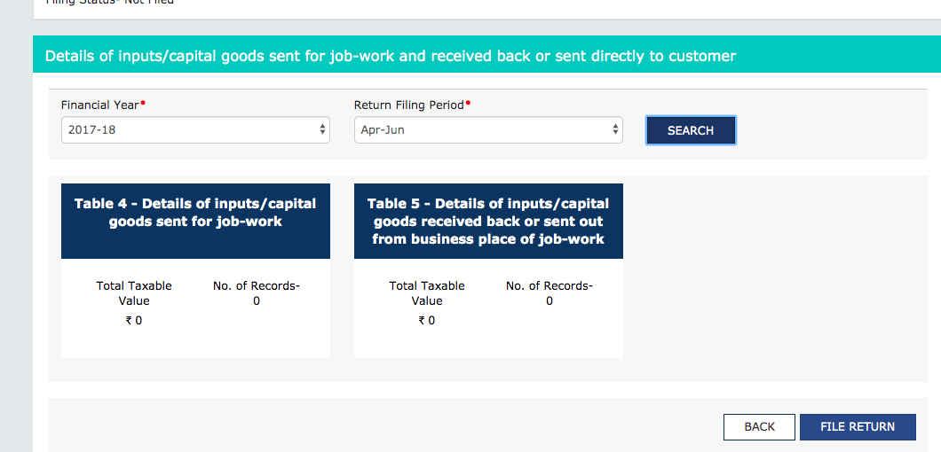
ITC 04: Retrun for goods sent to job worker

Slide 19
ITC 04: When to use
ITC 04 is a return required to be filed by a person sending goods to a job worker.
This return contains the details of goods send or received from a job worker.
A principal following the procedure of section 143 of CGST Act is required to file it.

