Slide 1
CA Rishabh Aggarwal Email: rishabhagg.ca@gmail.com Mobile: +91-9654264464
`
“GST ANNUAL RETURN”

Slide 2
GST Annual Return
GSTR-9

Slide 3
Overview of GSTR-9
GSTR 9/9A is an annual return to be filed once in a year by the registered taxpayers under GST including those registered under composition levy scheme.
It consists of details regarding the supplies made and received during the year under different tax heads i.e. CGST, SGST and IGST.
It consolidates the information furnished in the monthly/quarterly returns during the year.

Slide 4
Who should file GSTR-9?
All the registered taxable persons under GST must file GSTR 9

Slide 5
Persons are not required to file GSTR 9
Casual Tax Person
Input Service Distributors
Non-resident Taxable Persons
Person under section – 51 of CGST Act.

Slide 6
GSTR-9 Due Date
GSTR-9 shall be filed on or before 31st December of the subsequent financial year.
For instance for FY 2017-18, the due date for filing GSTR 9 is 30th June, 2019.

Slide 7
About Form GSTR-9
6 Parts
19 Tables
GSTR -9

Slide 8
Total parts ?
Annual Return
Part 1
Part VI
Part V
Part IV
Part III
Part II

Slide 9
Part – I (Basic Details )
Part 1
1. FY
3B. Trade Name
3A. Legal Name
2. GSTN

Slide 10
Part – II (Details of Outward and inward supplies declared made the financial year)
Table 4 - Details of advances, inward and outward supplies made during the financial year on which tax is payable
Table 5 - Details of advances, inward and outward supplies made during the financial year on which tax is not payable
Part - II

Slide 11
Points to be noted
It is mandatory to file all your FORM GSTR-1 and FORM GSTR-3B for the FY 2017-18 before filing this return.The details for the period between July 2017 to March 2018 are to be provided in this return.
It may be noted that additional liability for the FY 2017-18 not declared in FORM GSTR-1 and FORM GSTR-3B may be declared in this return. However, taxpayers cannot claim input tax credit unclaimed during FY 2017-18 through this return.

Slide 12
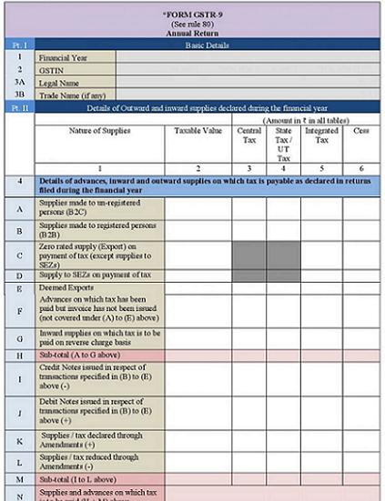

Slide 13
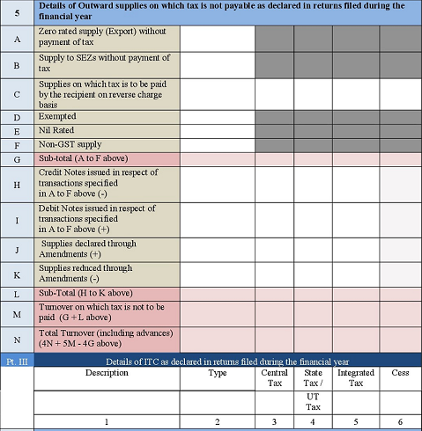

Slide 14
Part – III (Details of ITC as declared in returns filed during for the financial year)
Part III
Table 6
(Details of ITC availed as declared in returns filed during for the financial year)
Table 7
(Details of ITC Reversed and Ineligible ITC as declared in returns filed during for the financial year)
Table 8
(Other ITC related information)
Reconciliation between the credit claimed in GSTR-3B and GSTR-2A available on GST portal

Slide 15
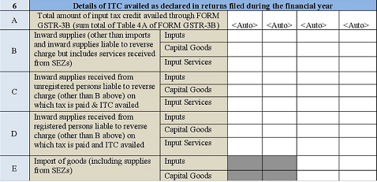

Slide 16
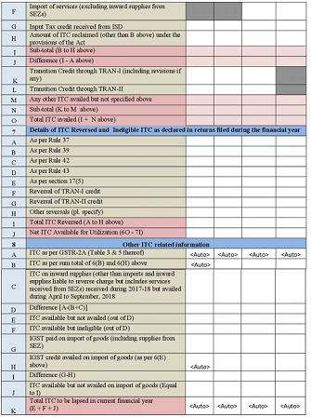

Slide 17
Part IV
Details of tax paid as declared in returns filed during the financial year

Slide 18
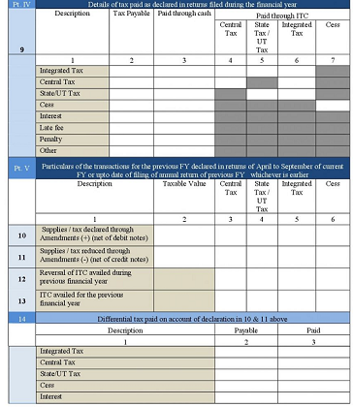

Slide 19
Part V (Particulars of the transactions for the previous FY declared in returns of April to September of current FY or upto date of filing of annual return of previous FY whichever is earlier)
Table 10
Supplies / tax declared through Amendments (+) (net of debit notes)
Table 11
Supplies / tax declared through Amendments (+) (net of debit notes)
Table 12
Reversal of ITC availed during previous financial year
Table 13
ITC availed for the previous financial year
Table 14
Differential tax paid on account of declaration in 10 & 11 above

Slide 21
Part VI (Other Information)
Table 15
Particulars of Demands and Refunds
Table 16
Information on supplies received from composition taxpayers, deemed supply under section 143 and goods sent on approval basis
Table 17
HSN Wise Summary of outward supplies
Table 18
HSN Wise Summary of Inward supplies
Table 19
Late fee payable and paid

Slide 24
Analysis
Part III (ITC Availed including transitional ITC )
Part IV ( Payment of Taxes )
GSTR – 1 and 3.1(d) of GSTR – 3B for RCM liability Vs Books
Part II (Outward Supply & booking of RCM Liability )
Table 4A of GSTR – 3B , GSTR – 2A , Trans I and Trans II
GSTR – 3B

Slide 25
Lower will be Late fee
It is Rs 100 under CGST & 100 under SGST, total late fee is Rs 200 per day of default
0.5% of Turnover in the State/UT
(0.25% each for CGST & SGST )

Slide 26
Issues
GSTR – 3B and GSTR – 1 is not matching with Books – What to do ?
Exempted supply, Nil Rated and Non GST supply had not mentioned while filling GSTR – 1 and GSTR – 3B – what to do ?
Blockage of credit u/s 17(5) not entered in 3B ?

Slide 27
Issues
ITC availed via GSTR – 3B Reco for FY 2017- 18 with GSTR – 2A ?
GSTR – 3B bifurcation with Input goods / Input Services / Capital Goods ?
Inward supplies from composition dealers, deemed supply from job workers etc. are required to be reported separately while filling Annual return.

Slide 28
Issues
HSN wise details for inward supplies was not required to be reported in GSTR-3B but the same details have to mentioned in Annual return.
It appears that any additional liability arising out of error/omission in GSTR-1 and GSTR-3B cannot be paid at the time of filing annual return.

Slide 29
FAQs

Slide 30
FAQs
Is it mandatory to file Form GSTR-9 - Yes, it’s mandatory to file Form GSTR-9 for normal taxpayers who are filing GSTR-1/3B.
Do a Registered Person need to file Form GSTR-9 or Form GSTR- 9A - The period during which the taxpayer remained as composition taxpayer, Form GSTR-9A is required to be filed. And, for period for which the taxpayer is registered as normal taxpayer, Form GSTR-9 is required to be filed.
If registration got cancelled in the financial year. Is it required to file Form GSTR-9 - Yes, the annual return needs to be filed even if the taxpayer has got his registration cancelled during the said financial year.

Slide 31
FAQs
Form GSTR-9 return is required to be filed at entity level or GSTIN level - Form GSTR-9 return is required to be filed at GSTIN level i.e. for each registration.
Can RP edit auto populated data from filed Form GSTR-1 and GSTR- 3B in Form GSTR-9 - Yes, you can edit auto-populated data from filed Form GSTR-1 and GSTR-3B in Form GSTR-9, except ITC as per 3B, ITC as per 2A and details of tax paid.

Slide 32
FAQs
Will consolidated summary of Form GSTR-1/3B be made available for the returns filed during the financial year - Yes. Consolidated summary of all filed Form GSTR-1/3B statement for the relevant financial year is available for download in PDF format.
What happens after COMPUTED LIABILITIES button is clicked - After COMPUTE LIABILITIES button is clicked, details provided in various tables are processed on the GST Portal at the back end and Late fee liabilities, if any, are computed. Late fee is calculated, if there is delay in filing of annual return beyond due date

Slide 33
FAQs
Is there any option to make payment (if applicable) in Form GSTR-9? - .Any additional payment can be made using Form GST DRC-3 functionality only through utilization from Electronic Cash Ledger.
In Form GSTR-9, can additional liability not reported earlier in Form GSTR-3B be declared - Yes, additional liability not reported earlier at the time of filing Form GSTR- 3B can be declared in Form GSTR-9.The additional liability so declared in Form GSTR-9 are required to be paid through Form GST DRC-03.

Slide 34
FAQs
Can we claim or report any unclaimed ITC through Annual Return? - No. we cannot claim ITC through Form GSTR-9.
Can we revise Form GSTR-9 return after filing - No, we cannot revise Form GSTR-9 return after filing.

Slide 35
`
CA Rishabh Aggarwal
Email: rishabhagg.ca@gmail.com
Mobile: 09654264464

