Slide 1
TDS in GST
Team ConsultEase

Slide 2
Who is required to deduct TDS in GST?
Following is the list of the person required to deducts the TDS in GST as notified by notification no. 50/2018- Central Tax. As per this notification, the provisions of this section will be applicable from
(a) a department or establishment of the Central Government or State Government; or
(b) local authority(Slide 3); or
(c) Governmental agencies; or
(d) such persons or category of persons as may be notified by the Government on the recommendations of the Council:

Slide 3
Following categories are notified via Notification No. 50/2018 – Central Tax dated 13th September 2018.
(a) an authority or a board or any other body, – (i) set up by an Act of Parliament or a State Legislature; or (ii) established by any Government, with fifty-one percent. or more participation by way of equity or control, to carry out any function;
(b) The society established by the Central Government or the State Government or a Local Authority under the Societies Registration Act, 1860 (21 of 1860);
(c) public sector undertakings(Slide 4).

Slide 4
Definitions of Important terms
As per Section 2(69) CGST Act
“local authority” means––
(a) a “Panchayat” as defined in clause (d) of article 243 of the Constitution;
(b) a “Municipality” as defined in clause (e) of article 243P of the Constitution;
(c) a Municipal Committee, a Zilla Parishad, a District Board, and any other authority legally entitled to, or entrusted by the Central Government or any State Government with the control or management of a municipal or local fund;
(d) a Cantonment Board as defined in section 3 of the Cantonments Act, 2006;
(e) a Regional Council or a District Council constituted under the Sixth Schedule to the Constitution;
(f) a Development Board constituted under article 371 of the Constitution; or
(g) a Regional Council constituted under article 371A of the Constitution;

Slide 5
As per section 617 of the Companies Act, 1956:
“Public Sector undertaking or Government Company ” means-
For the purposes of this Act, Government company means any company in which not less than fifty-one per cent of the paid-up share capital is held by the Central Government, or by any State Government or Governments, or partly by the Central Government and partly by one or more State Governments and includes a company which is a subsidiary of a Government company as thus defined.

Slide 6
When TDS will be deducted in GST?
TDS will be deducted when the amount of supply in a contract is more than Rs. 2,50,000.

Slide 7
On which amount TDS in GST will be deducted?
TDS in GST will be deducted on the amount of payment(Taxable value) made by the notified person.
For the purpose of deduction of tax specified above, the value of supply shall be taken as the amount excluding the central tax, State tax, Union territory tax, integrated tax, and cess indicated in the invoice.

Slide 8
When TDS in GST is required to be deposited to the account of government?
The TDS is required to be deposited on 10th of next month in which the amount is deducted.

Slide 9
When GST TDS is not required to be deducted?
As per the provisions of section 51 of CGST Act, no deduction of TDS shall be made if the location of the supplier and the place of supply is in a State or Union territory which is different from the State or as the case may be, Union territory of registration of the recipient. We have simplified it with the help of the following table.

Slide 10
Location of Supplier | Place of Supply | Location of Recipient | Applicability of TDS | Tax
Haryana | Haryana | Haryana | Yes | Haryana CGST Haryana GST
Haryana | Rajasthan | Rajasthan | Yes | IGST
Haryana | Haryana | Rajasthan | Not Applicable | Haryana CGST Haryana GST
Haryana | Punjab | Rajasthan | Applicable | IGST
Haryana | Rajasthan | Haryana | Applicable | IGST

Slide 11
When the return of TDS in GST is required to be filed?
As per the provisions of section 39, the return of TDS is required to be filed by the 10th of next month.

Slide 12
In which form the return for TDS in GST will be filed?
The return of GST will be filed in FORM GSTR -7.

Slide 13
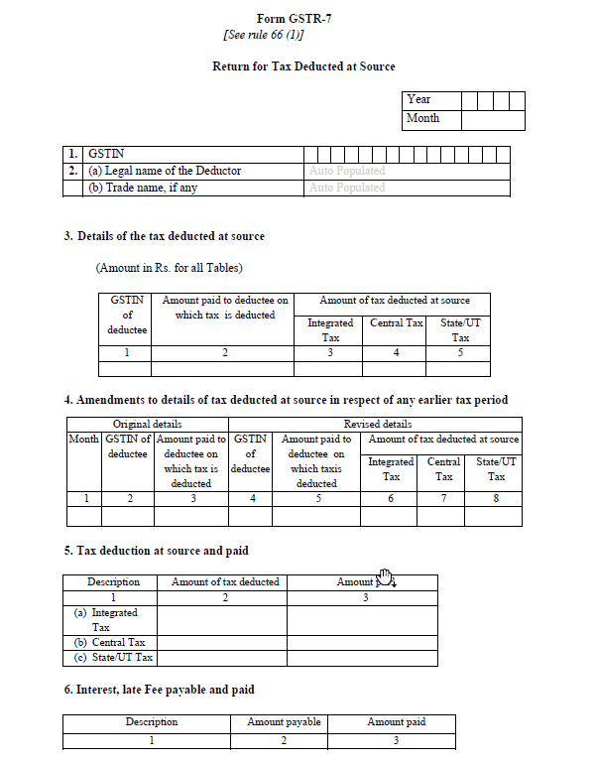
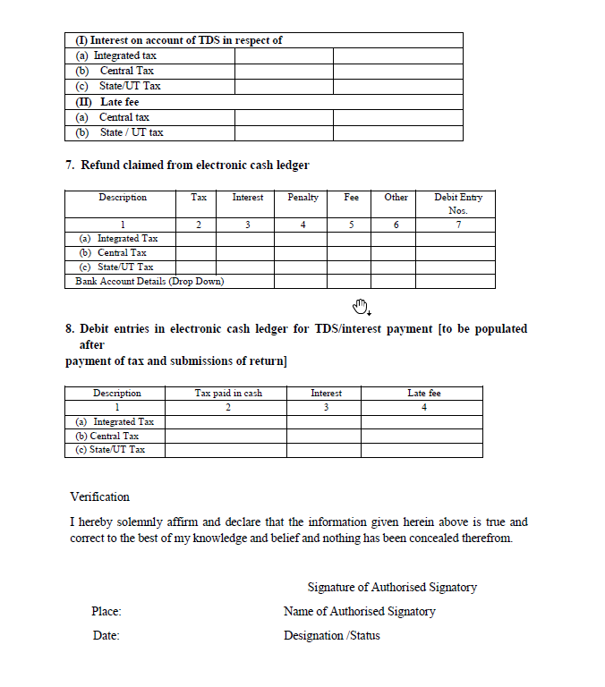
GSTR-7

Slide 14
In which form the certificate for TDS in GST will be issued.
The certificate for deduction of deduction of GST TDS will be issued in FORM GSTR 7A.

Slide 15
GSTR-7A
Form GSTR 7A
[See rule 66(3)]
Tax Deduction at Source Certificate
1. TDS Certificate No. –
2. GSTIN of deductor –
3. Name of deductor –
4. GSTIN of deductee –
5. (a) Legal name of the deductee -
(b) Trade name, if any –

Slide 16
6. Tax period in which tax deducted and accounted for in GSTR-7 –
7. Details of supplies Amount of tax deducted –
Value on Which tax deducted | Amount of Tax deducted at source (Rs.)
 | Integrated Tax | Central Tax | State/UT Tax
(1) | (2) | (3) | (4)
Signature
Name
Designation
Office -

Slide 17
In how many days TDS certificate in GST is required to be provided to deductee?
TDS certificate is required to be furnished within 5 days of crediting that amount to the account of government.

Slide 18
What is the late fees for the non-furnishing of GST TDS certificate?
A late fee of one hundred rupees per day from the day after the expiry of such five days period until the failure is rectified, subject to a maximum amount of five thousand rupees.

Slide 19
Option I - Individual Bill-wise Deduction and its Deposit by the DDO
In this option, the DDO will have to deduct as well as deposit the GST TDS for each bill individually by generating a CPIN (Challan) and mentioning it in the Bill itself.
Following process shall be followed by the DDO in this regard:
(i) The DDO shall prepare the Bill based on the Expenditure Sanction. The Expenditure Sanction shall contain the (a) Total amount, (b) net amount payable to the Contractor/Supplier/Vendor and (c) the 2% TDS amount of GST.
(ii) The DDO shall login into the GSTN Portal (using his GSTIN) and generate the CPIN (Challan). In the CPIN he shall have to fill in the desired amount of payment against one/many Major Head(s) (CGST/SGST/UTGST/IGST) and the relevant component (e.g. Tax) under each of the Major Head.

Slide 20
(iii) While generating the CPIN, the DDO will have to select mode of payment as either (a) NEFT/RTGS or (b) OTC. In the OTC mode, the DDO will have to select the Bank where the payment will be deposited through OTC mode.
(iv) The DDO shall prepare the bill on PFMS (in case of Central Civil Ministries of GoI), similar payment portals of other Ministries/Departments of GoI or of State Governments for submission to the respective payment authorities.
(v) In the Bill,
(a) the net amount payable to the Contractor; and
(b) 2% as TDS
will be specified
(vi) In case of NEFT/RTGS mode, the DDO will have to mention the CPIN Number (as beneficiary’s account number), RBI (as beneficiary) and the IFSC Code of RBI with the request to payment authority to make payment in favour of RBI with these credentials.

Slide 21
(vii) In case of the OTC mode, the DDO will have to request the payment authority to issue ‘A’ Category Government Cheque in favour of one of the 25 authorized Banks. The Cheque may then be deposited along with the CPIN with any of branch of the authorized Bank so selected by the DDO.
(viii) Upon successful payment, a CIN will be generated by the RBI/Authorized Bank and will be shared electronically with the GSTN Portal. This will get credited in the electronic Cash Ledger of the concerned DDO in the GSTN Portal. This can be viewed and the details of CIN can be noted by the DDO anytime on GSTN portal using his Login credentials.
(ix) The DDO should maintain a Register as per proforma given in Annexure ‘A’ to keep record of all TDS deductions made by him during the month. This Record will be helpful at the time of filing Monthly Return (FORM GSTR-7) by the DDO. The DDO may also make use of the offline utility available on the GSTN Portal for this purpose.
(x) The DDO shall generate TDS Certificate through the GST Portal in FORM GSTR-7A after filing of Monthly Return.

Slide 22
Option II - Bunching of deductions and its deposit by the DDO
Option-I may not be suitable for DDOs who make large number of payments in a month as it would require them to make large number of challans during the month. Such DDOs may exercise this option wherein the DDO will have to deduct the TDS from each bill, for keeping it under the Suspense Head. However, deposit of this bunched amount from the Suspense Head can be made on a weekly, monthly or any other periodic basis.
Following process shall be followed by the DDO in this regard:
(i) The DDO shall prepare the Bill based on the Expenditure Sanction. The Expenditure Sanction shall contain the (a) Total amount, (b) net amount payable to the Contractor/Supplier/Vendor and (c) the 2% TDS amount of GST.
(ii) The DDO shall prepare the bill on PFMS (in case of Central Civil Ministries of GoI), similar payment portals of other Ministries/Departments of GoI or of State Governments for submission to the respective payment authorities.

Slide 23
(iii) In the Bill, it will be specified
(a) the net amount payable to the Contractor; and
(b) 2% as TDS
(iv) The TDS amount shall be mentioned in the Bill for booking in the Suspense Head (8658 - Suspense; 00.101 - PAO Suspense; xx – GST TDS)
(v) The DDO will require to maintain the Record of the TDS so being booked under the Suspense Head so that at the time of preparing the CPIN for making payment on weekly/monthly or any other periodic basis, the total amount could be easily worked out.
(vi) At any periodic interval, when DDO needs to deposit the TDS amount, he will prepare the CPIN on the GSTN Portal for the amount (already booked under the Suspense Head).
(vii) While generating the CPIN, the DDO will have to select mode of payment as either (a) NEFT/RTGS or (b) OTC. In the OTC mode, the DDO will have to select the Bank where the payment will be deposited through OTC mode.

Slide 24
(viii) The DDO shall prepare the bill for the bunched TDS amount for payment through the concerned payment authority. In the Bill, the DDO will give reference of all the earlier paid bills from which 2% TDS was deducted and kept in the suspense head. The DDO may also attach a certified copy of the record maintained by him in this regard.
(ix) The payment authority will pass the bill by clearing the Suspense Head operated against that particular DDO after exercising necessary checks.
(x) In case of NEFT/RTGS mode, the DDO will have to mention the CPIN Number (as beneficiary’s account number), RBI (as beneficiary) and the IFSC Code of RBI with the request to payment authority to make payment in favour of RBI with these credentials.
(xi) In case of the OTC mode, the DDO will have to request the payment authority to issue ‘A’ Category Government Cheque in favour of one of the 25 authorized Banks. The Cheque may then be deposited along with the CPIN with any of branch of the authorized Bank so selected by the DDO.
(xii) Upon successful payment, a CIN will be generated by the RBI/Authorized Bank and will be shared electronically with the GSTN Portal. This will get credited in the electronic Cash Ledger of the concerned DDO in the GSTN Portal. This can be viewed and the details of CIN can be noted by the DDO anytime on GSTN portal using his Login credentials.

Slide 25
(xiii) The DDO should maintain a Register as per proforma given in Annexure ‘A’ to keep record of all TDS deductions made by him during the month. This Record will be helpful at the time of filing Monthly Return (FORM GSTR-7) by the DDO. The DDO may also make use of the offline utility available on the GSTN Portal for this purpose.
(xiv) The DDO shall file the Return in FORM GSTR-7 by 10th of the following month
(xv) The DDO shall generate TDS Certificate through the GSTN Portal in FORM GSTR-7A

