Slide 1
Standard Operating Procedure for enabling dealers to migrate to GST regime
23rd July’ 2018
GSTN

Slide 2
Our Approach to Resolve the issues
State SPOC’s / CBIC to provide list of GSTIN’s on gstn.nodal@gstn.org.in who have activated part A of the enrolment application and created user id and password.
Before proceeding ahead states / CBIC to direct the jurisdictional authorities to ensure that the SOP mentioned along with this PPT is understood and actions are taken accordingly.
Taxpayers to do new Registration as Normal Taxpayer with all the correct details and submit the Registration Form GST REG-01. In the business detail tab they need to furnish TIN / Central Excise registration no. / Service tax registration no.

Slide 3
Our Approach to Resolve the issues
Post approval of the new registration application, Taxpayer will receive a system generated email with new GSTIN ID and token. Taxpayer needs to ignore the first email as a different GSTIN id will get generated for new application. Taxpayer needs to send the new GSTIN received + ARN (application reference no) with old GSTIN on migration@gstn.org.in
Tax Payer shall not use the GSTIN particulars received through first email for creating User id/Password etc. He should wait for confirmation form GSTN.
Once the backend activity of migration is completed, Automated System Generated Email will be sent to Tax Payer mentioning correct Old GSTIN with request to login with old GSTIN and token.
Tax Payer is required to login with the received credentials using first time login link https://services.gst.gov.in/services/newlogin and create login credentials for the same.

Slide 4
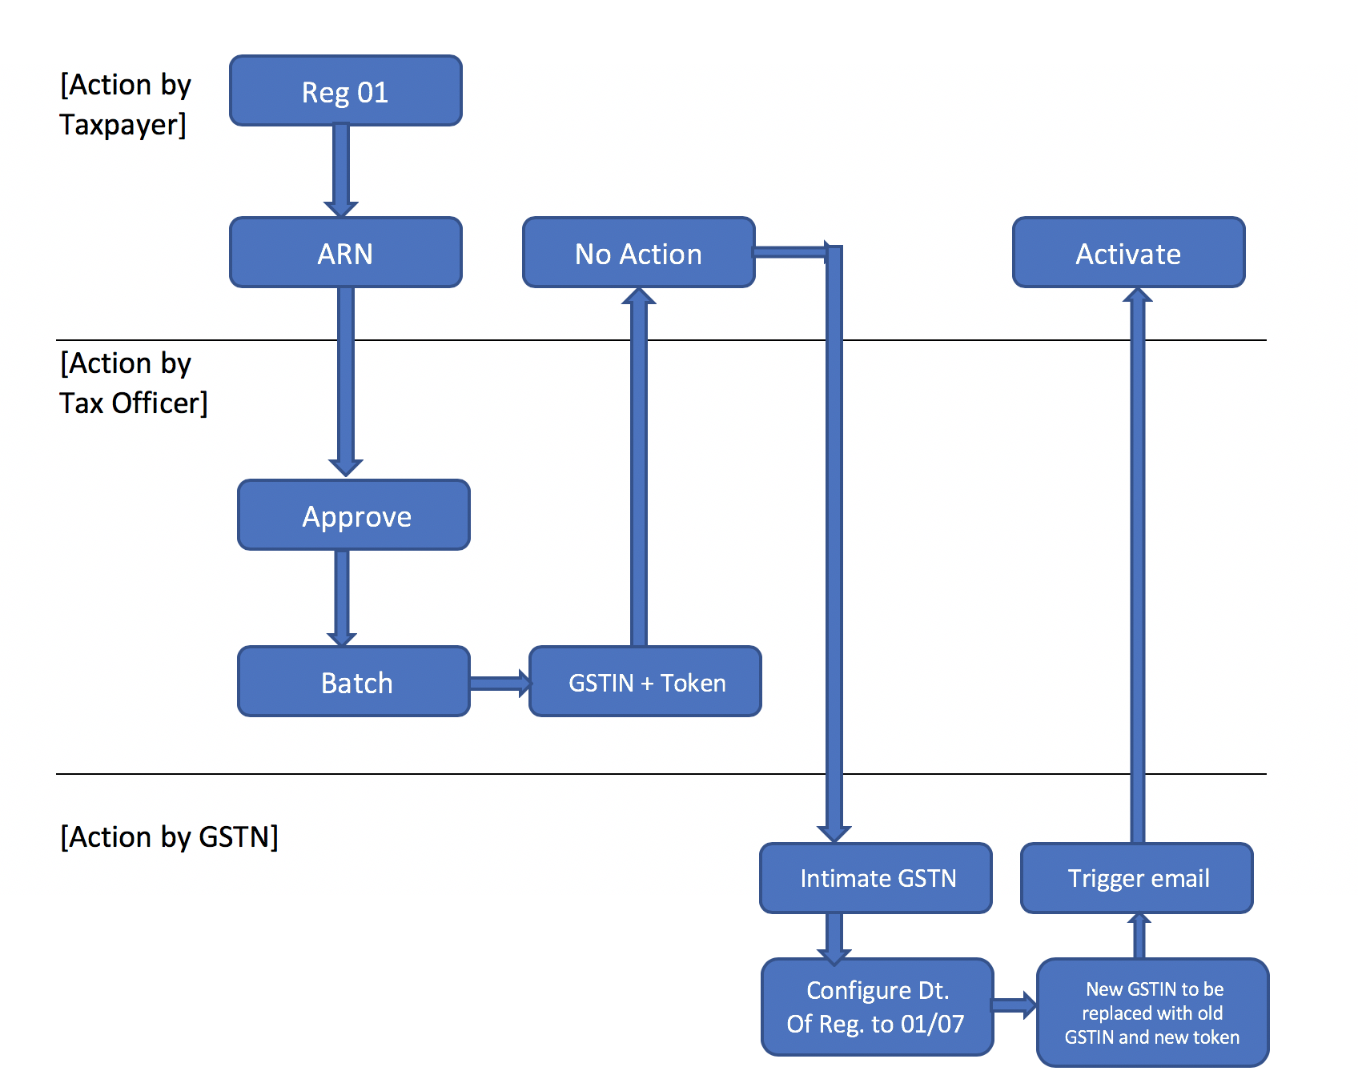
Process Flow

Slide 5
Thank You

