Slide 1
E-Way Bill and Process
Vikas Joshi , Deputy Commissioner , CCO , Jaipur Zone

Slide 2
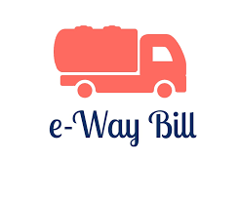
E-way Bill-Rules
RULE No: | Description
138 | Information to be furnished prior to commencement of movement of goods and generation of e-way bill.
138-A | Documents and devices to be carried by a person -in-charge of a conveyance.
138-B | Verification of documents and conveyances.
138-C | Inspection and verification of goods.
138-D | Facility for uploading information regarding detention of vehicle

Slide 3
E-way Bill - Forms
Form No: | Description
GST EWB -01 | E - Way Bill
GST EWB -02 | Consolidated E-Way Bill
GST EWB -03 | Verification Report.
GST EWB -04 | Report of Detention
GST INV–1 | Generation of Invoice Reference Number

Slide 4
E way Bill – Process
EWB Process is a new aspect for Central Tax Officers but that is not new for State Tax officers across the country.
A Game Changer in GST system as it Streamlines transport system, Standardize the Business process and improves compliance mechanism resulting in improved revenue collections
A Government given Document for Movement of Goods One Nation-One Tax and One Document for movement across the states.
Earlier as and when a consignment entered a state , separate Way Bill / form was to be generated . But now one Document covering one nation will suffice.

Slide 5
A paradigm Shift
From
“Departmental Policing Model” – a post movement capture model
(Move and make him to account)
Towards
“Self Declaration Model”, a pre movement capture model
( Account First and Move Later)

Slide 6
Objectives
1
One e-waybill for movement of the goods throughout the country
2
Hassle free movement of goods for transporters throughout the country
4
No need for Transit Pass in any state
5
Easier verification of the e-waybill by officers with complete details
3
Controlling the tax evasion

Slide 7
Benefits
The traders need not visit tax offices anymore.
Average waiting time at check-post reduces drastically
Scope for discretionary power eliminated.
Self-policing by traders. A trader while uploading gives the identification of the buyer / trader who also has to account the transaction.
Environment friendly – nearly 50 tons of paper saved per day.
An accurate database created-useful for tax analysis.
Revenue growth will be more due to better tax compliance.
Complete Transparency of Transactions

Slide 8
What is E-Way Bill?
E-way bill (FORM GST EWB-01) is an electronic document (available to supplier / recipient / transporter) generated on the common portal evidencing movement of goods of consignment value more than Rs. 50,000/-. It has two Components-
Part A comprising of details of GSTIN of recipient, place of delivery (PIN Code), invoice or challan number and date, value of goods, HSN code, transport document number (Goods Receipt Number or Railway Receipt Number or Airway Bill Number or Bill of Lading Number) and reasons for transportation; and
Part B –comprising of transporter details (Vehicle number).
Notes:
Identifies the goods; recipient; location; transporter

Slide 9
Generation of E-way Bill
Every registered person who causes movement of goods of consignment value exceeding fifty thousand rupees
In relation to supply; or
For reasons other than supply;
( sales returns; stock transfer; movement for job work etc) or
Due to inward supply from unregistered person,
Notes:
Every registered person( That means unregistered person need not issue e-way bill even if the consignment value is more than Rs. 50000/-); One who cause movement of goods… need to fill form GST INS –Part A;

Slide 10
E-Way Bill (Contd)
shall, before commencement of movement, furnish information relating to the said goods in Part A of FORM GST EWB-01, electronically, on the common portal,
along with such other information as may be required on the common portal and a unique number will be generated on the said portal

Slide 11
Who will generate E Way Bill?
Regd Consignor/Recipient; or their authorised regd/enrolled Transporter; or consignor’s authorised Ecom operator/Courier agency - for > 50K consignment value.
When regd C/R fill only Part A, then Transporter will fill Part B. [EWB invalid without Part B]
Multi consignments with no EWBs if transported in one vehicle (not rail,air,vessel) and aggregate of consignment value is above 50 thousand, then transporter will generate multiple EWBs and then may also consolidate. [138(7)]
Either party in case of inter-state job work movement (for any value)
Inter-state URD supplier of handicraft (for any value). [Notf 32/17 CT 15.9.17]

Slide 12
Who will generate E Way Bill? (Contd)
Rail/Air/Vessel- Regd C/R; before/after commencement, Railway will not give delivery unless EWB produced at delivery.
If URD to RD, then RD recipient will generate.
If URD to URD, [if URD causing movement or his transporter at their option (?) will generate after enrolling as citizen.] [second proviso to R 138(3)]
ECOm will fill pt A; and either ECOm or third party logistic service provider will fill part B
Use of Part A information- Supplier may use in GSTR-1 [138(8)]

Slide 13
Validity of unique number
Second Proviso to Rule 138(9):
Provided further that the unique number generated under sub-rule (1) shall be valid for a period of fifteen days for up-dation of Part B of FORM GST EWB-01.
Thus Unique number generated after uploading of Part A shall be valid now for 15 days for generation of E-way Bill ( adding Part-B)

Slide 14
Consignment value
Explanation 2 to Rule 138(1) amended
Explanation 2.- For the purposes of this rule, the consignment value of goods shall be the value, determined in accordance with the provisions of section 15, declared in an invoice, a bill of supply or a delivery challan, as the case may be, issued in respect of the said consignment and also includes the central tax, State or Union territory tax, integrated tax and cess charged, if any, in the document and shall exclude the value of exempt supply of goods where the invoice is issued in respect of both exempt and taxable supply of goods.
Thus value of exempt supplies will not be included for calculation of consignment value of goods ( < or > Rs.50,000/-)

Slide 15
Whether an e-way bill is to be issued, even when there is no supply?
Yes. Even if the movement of goods is caused due to reasons others than supply, the e-way bill is required to be issued.
Reasons other than supply include movement of goods due to
export/import,
job-work,
SKD or CKD,
recipient not known,
supply of liquid gas where quantity is not known,
supply returns,
exhibition or fairs,
for own use,
supply on approval basis and others etc.

Slide 16
What if
What if the value less than Rs. 50, 000/-
E-way bill not compulsory
Optional
Movement caused by unregistered person, and
Recipient is also unregistered or unknown
E-way bill not compulsory
Optional

Slide 17
What is the concept of acceptance of e-way bill by the recipient?
The details of e-way bill generated shall be made available to the recipient, if registered, on the common portal, who shall communicate his acceptance or rejection of the consignment covered by the e-way bill.
Deemed Acceptance:
In case, the recipient does not communicate his acceptance or rejection within seventy-two hours of the details being made available to him on the common portal, it shall be deemed that he has accepted the said details.

Slide 18
What if
E way Bill and EBN generated, but goods not transported?
Cancel E Way Bill within 24 hours of its generation
If E Way bill verified in transit,
it cannot be cancelled

Slide 19
Validity of EWB
Validity period for E Way Bill in Rule 138(10) amended; Differential validity for over dimensional cargo
S/No. | Distance | Validity
1 | Up to 100 km. | One day in cases other than Over Dimensional Cargo
2 | For every 100 km. or part thereof thereafter | One additional day in cases other than Over Dimensional Cargo
3 | Up to 20 km | One day in case of Over Dimensional Cargo
4 | For every 20 km. or part thereof thereafter | One additional day in case of Over Dimensional Cargo

Slide 20
Extension of Validity of E Way Bill
Proviso to Rule 138(10) amended
Provided further that where, under circumstances of an exceptional nature, including trans-shipment, the goods cannot be transported within the validity period of the e-way bill, the transporter may extend the validity period after updating the details in Part B of FORM GST EWB-01, if required.
Notes:
Earlier the transporter was required to generate new E way Bill; Now he can extend the validity period

Slide 21
Concept of one day
Explanation to Rule 138(10) amended
Explanation 1.—For the purposes of this rule, the “relevant date” shall mean the date on which the e-way bill has been generated and the period of validity shall be counted from the time at which the e-way bill has been generated and each day shall be counted as the period expiring at midnight of the day immediately following the date of generation of e-way bill.
Notes:
Earlier One day was ending after 24 hours from the time when the e way bill is generated

Slide 22
Cases where no E Way Bill Required
Rule 138(14) amended; New serial no. h to n added where no way bill required to be generated
(h) where the goods are being transported— (i) under customs bond from an inland container depot or a container freight station to a customs port, airport, air cargo complex and land customs station, or from one customs station or customs port to another customs station or customs port, or (ii) under customs supervision or under customs seal;
(i) where the goods being transported are transit cargo from or to Nepal or Bhutan;
(j) where the goods being transported are exempt from tax under notifications No. 7/2017-Central Tax (Rate), dated 28.06.17 and No. 26/2017- Central Tax (Rate), dated the 21.09.17;

Slide 23
Cases where no E Way Bill Required
(k) any movement of goods caused by defence formation under Ministry of defence as a consignor or consignee;
(l) where the consignor of goods is the Central Government, Government of any State or a local authority for transport of goods by rail;
(m)where empty cargo containers are being transported; and
(n) where the goods are being transported up to a distance of twenty kilometers from the place of the business of the consignor to a weighbridge for weighment or from the weighbridge back to the place of the business of the said consignor subject to the condition that the movement of goods is accompanied by a delivery challan issued in accordance with rule 55.

Slide 24
No E-way Bill requirement
Consignor to Transporter & Transporter to Recipient distance is less than 50 Km.
Sale on ‘as is where is’ basis [ as no movement is there]

Slide 25
Documents to be carried with conveyance
Invoice or bill of supply or delivery challan, as the case may be
Or Invoice reference number generated on portal
A copy of the e-way bill or the e-way bill number, either physically or mapped to a Radio Frequency Identification Device (RFID) embedded on to the conveyance in such manner as may be notified by the Commissioner
RFID mapping may be made compulsory for class of transporters ( Notn by Commissioner)

Slide 26
Interception & Verification
RFID readers to be installed at places meant for verification
Physical verification to be by authorised proper officers
On receipt of specific information of evasion of tax, physical verification of a specific conveyance ….. after obtaining necessary approval of the Commissioner or an officer authorized by him in this behalf

Slide 27
What if delay due to inspection?
Facility for uploading information regarding detention of vehicle
Where a vehicle has been intercepted and detained for a period exceeding thirty minutes,
the transporter may upload the said information in FORM GST EWB- 04 on the common portal

Slide 28
E-Way Bill Format-EWB-01
PART A
GSTIN of Recipient - GSTIN or URP
Place of Delivery - PIN Code of Place
Invoice/Challan No - Number
Invoice/Challan Date - Date
Value of Goods -
HSN Code - At least 2 digit of HSN Code
Reason for Transport - Supply/Exp/Imp/Job Work/…
Transporter Doc. No - Document No provided by trans.
PART B
Vehicle Number - Vehicle Number

Slide 29
GST EWB-01
E Way Bill

Slide 30
Features of New System
User Friendly
Easy and Quick generation of e-Way Bill
Checks and balances
Creating own masters – Customers, Suppliers, Products
Personalized Dashboard
Monitoring the e-Way Bills generated

Slide 31
Features of New System
Multiple modes for e-Way Bill generation
Managing sub-users and Roles
Generating GSTR-1 from the e-Way Bills
Alerting through Online and SMS
QR code on the e-Way Bill

Slide 32
Modes of generation of E-way bill
Web – Online based
SMS – Through Mobile
Android – Through Mobile App
API – Site-to-Site integration
Bulk generation– Tool based
Suvidha Provider – Third Party based

Slide 33
Officer Activities
Verification of EWB and CEWB
Verification through Web, Android, SMS
Uploading of Inspection Report
Reports on Current data
User Mgmt by Nodal Officer

Slide 34
How to Start
Portal: The facility for generation, modification and cancellation of e-way bills is being provided on trial basis on the portal ewaybill.nic.in.
Once fully operational, the e-way bill system will start functioning on the portal ewaybillgst.gov.in

Slide 35
How to Start
Registration for GST Tax Payers
Register by entering GSTIN
Authenticate with OTP on registered mobile
Enrolment for GST Unreg/Transporters
Enrol by providing PAN details
Create Username and Password
Create Username and Password
Authenticate with OTP through Aadhar
Enter other business details

Slide 36
In pipeline
Dashboard Reports are being provided
RFID pilot in progress

Slide 37
Volume of Transactions
No. | Description | Total | Expected/day
1 | No of Tax payers to login | 1 crore | 20 Lakhs
2 | No of Transporters | 2 Lakhs | 2 Lakhs
3 | No of GST Officers | 30,000 | 8,000 – 10,000
4 | No of e-waybill generation | NA | 40 – 50 lakhs
5 | No of e-waybill updating with Vehicle No. | NA | 10 – 15 Lakhs
6 | No of e-waybill verification by Officers | NA | 5 – 8 Lakhs
7 | No of e-waybill acceptance/rejection by recipients | NA | 25 - 30 Lakhs

Slide 38
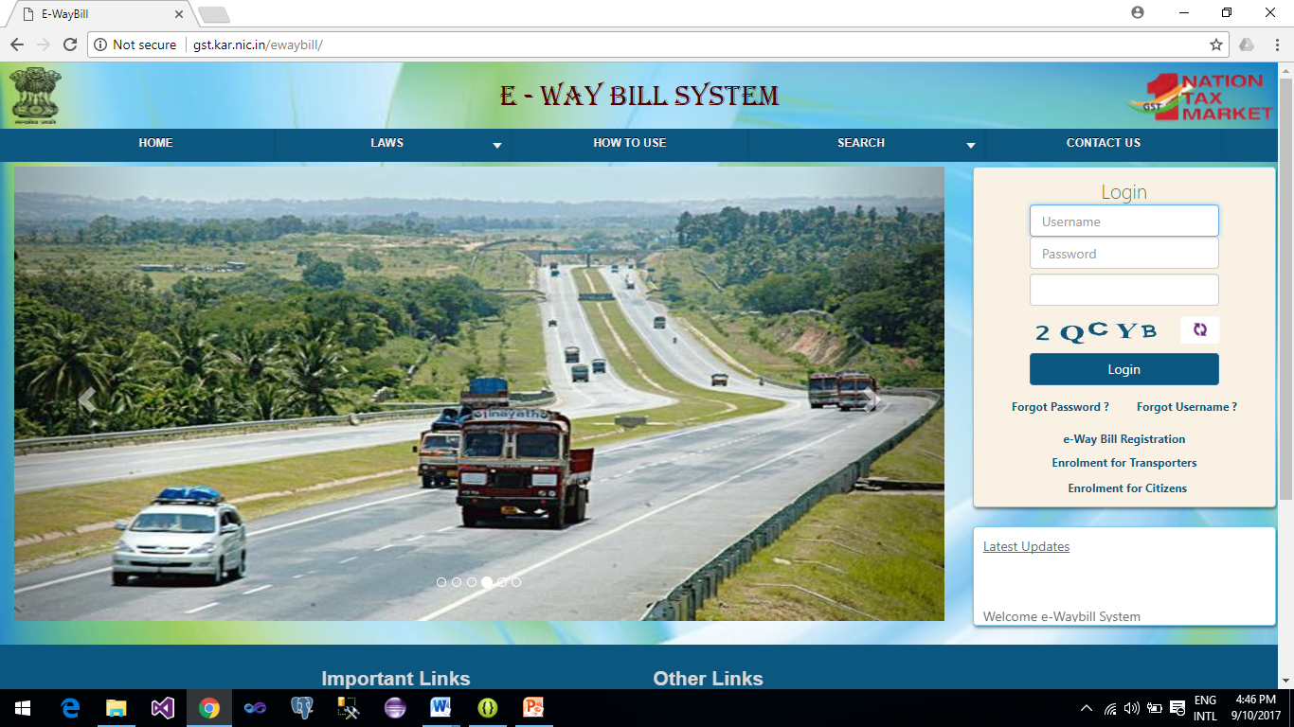
E-WAY BILL SYSTEM -
SMS Mode

Slide 39
SMS based E-way bill
Operations
Generate the E-Way Bill
Update the Vehicle details
Cancel the E-Way Bill
Pre-requisite
Registering the mobile number with the GSTIN on the EWB system

Slide 40
SMS – Generating Ewb Examples
Ex #1 | Message | EWBG OSUP 29AABCX0892K1ZK 560012 546 10/09/2017 75000.00 1001 KA12AB1234
 | SMS to | 97319 79899
 | Explanation | This request is to generate the E-Way Bill for outward Supply of goods, with HSN 1001, to recipient with GSTIN 29AABCX0892K1ZK, carrying Invoice/Bill No 546 dtd: 10/09/2017 of value Rs 75000.00 to deliver at pin code 560012 through KA12AB1234
 | Reply Message | Eway bill generated successfully. E-Way Bill No: 171000000144 and date is 12/09/2017
Ex #2 | Message | EWBG OEXP URP 560012 A1246 16/09/2017 59000.00 1001 MH01XY1233
 | SMS to | 97319 79899
 | Explanation | This request is to generate the E-Way Bill for export of goods, with HSN 1001, to recipient with GSTIN URP (UnRegistered Person), carrying Invoice/Bill No A1246 dtd: 16/09/2017 of value Rs 59000.00 to deliver at pin code 560012 through MH01XY1233
 | Reply Message | Eway bill generated successfully. E-Way Bill No: 181000000234 and date is 16/09/2017

Slide 41
SMS Alerts to Tax Payers
Every day the following message is sent to all the tax payers who are using EWB system
GSTIN: 29AAWPR3924N1ZM:
Your E-waybill statistics for : 06/12/2017-GENERATED BY YOU as
Outward: 7 (Value Rs. 3584882) ;
Rejected by you:1 (Value Rs 28000) ;
GENERATED BY OTHER PARTY as outward: 3 (Value Rs.1872500)

Slide 42
E-WAY BILL SYSTEM -
Mobile APP

Slide 43
Mobile App for EWB operations
Mobile (Android and ios) based app is developed for e-way bill operations
All the activities of e-way bill can be done on this app
IMEI of the mobile number needs to be registered on the EWB system to use the app

Slide 44
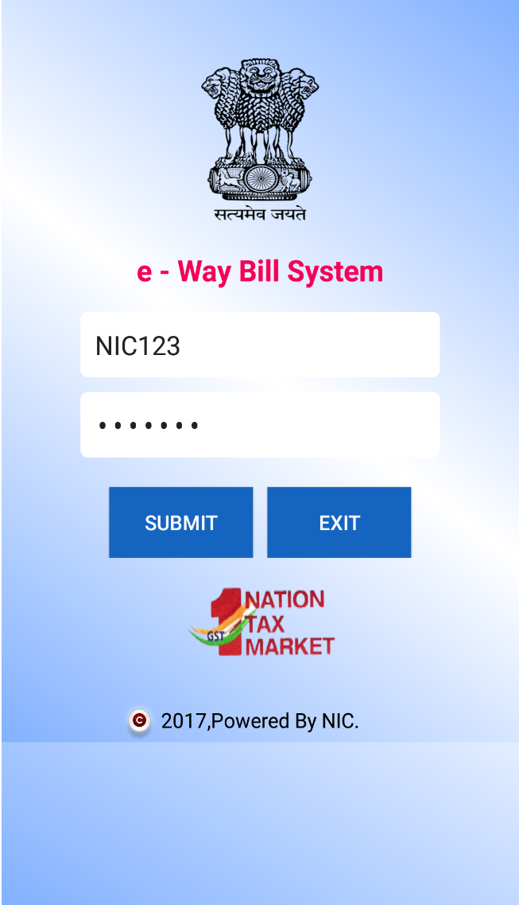
E-Way Bill Registration and Login

Slide 45
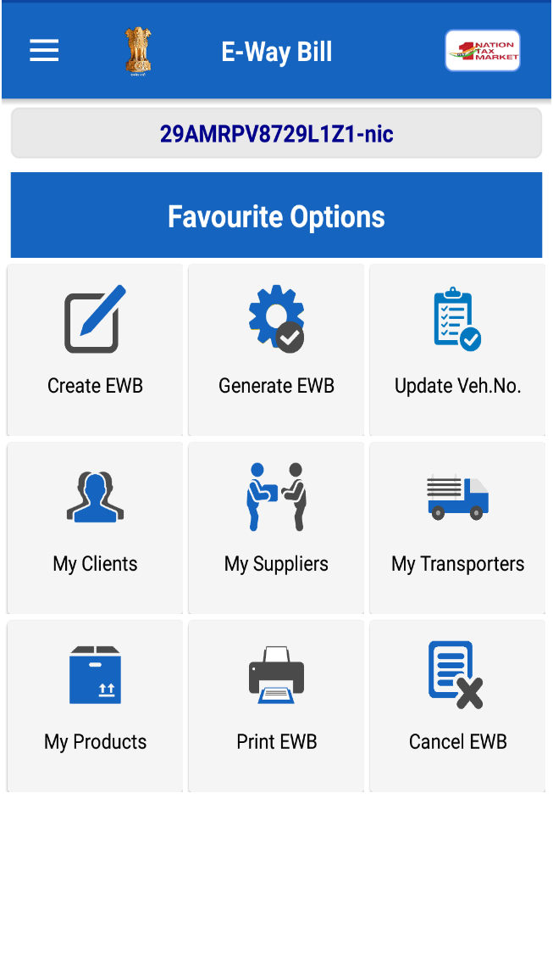
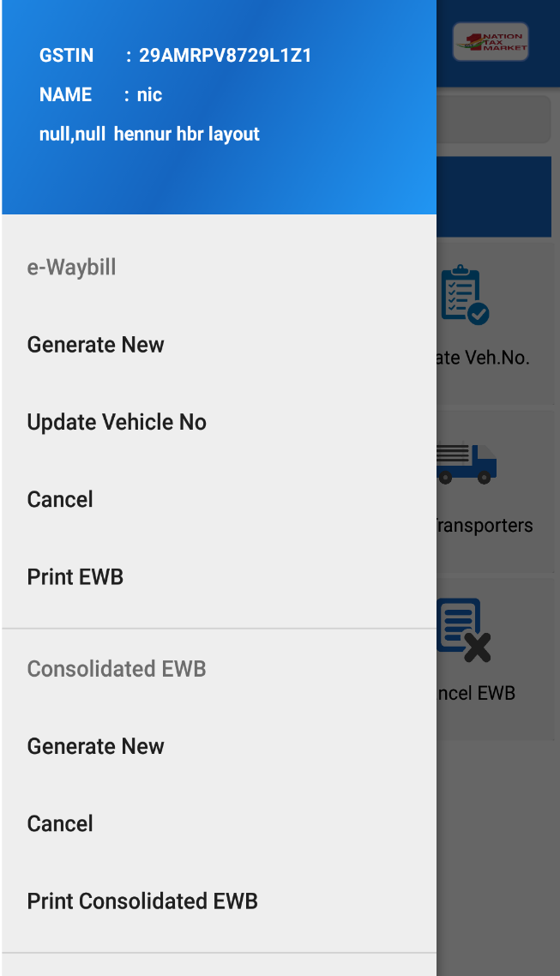
E-Way Bill Menu Options

Slide 46
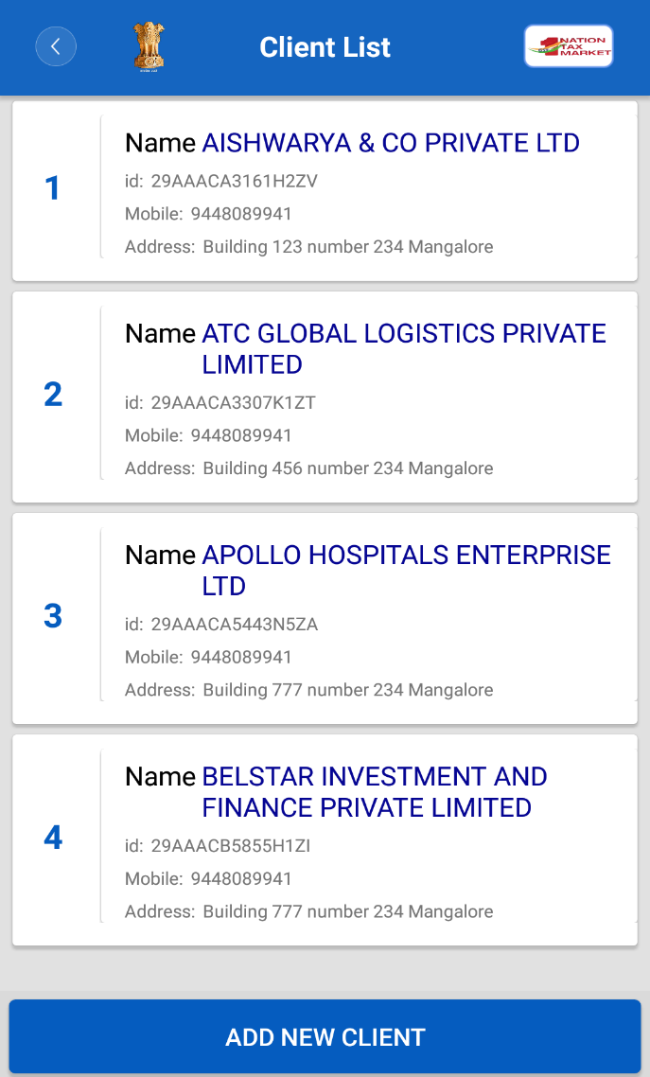
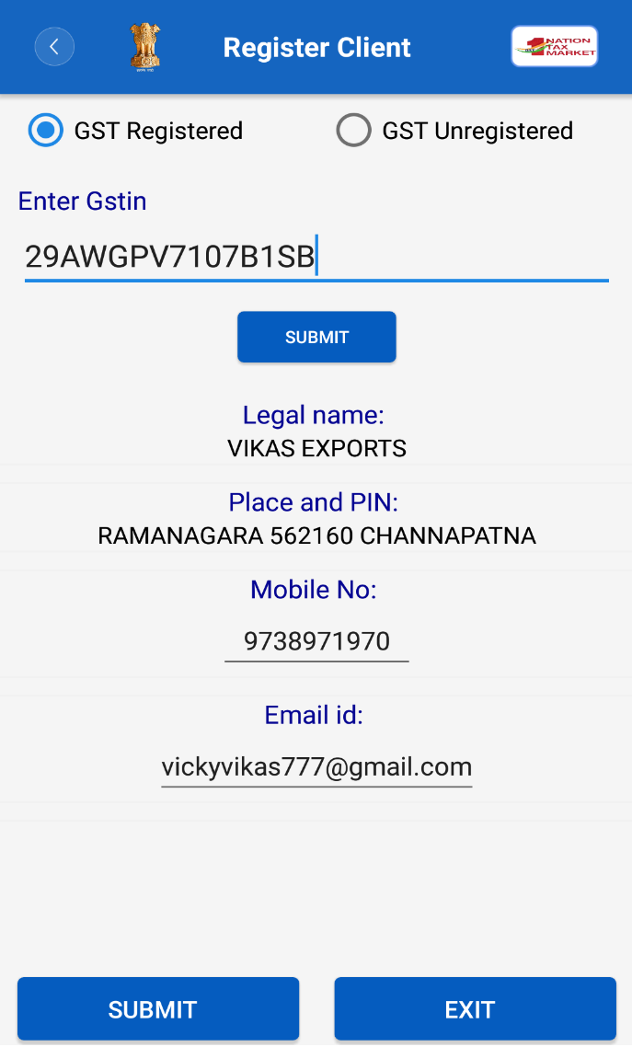
Adding My CLIENTs

Slide 47
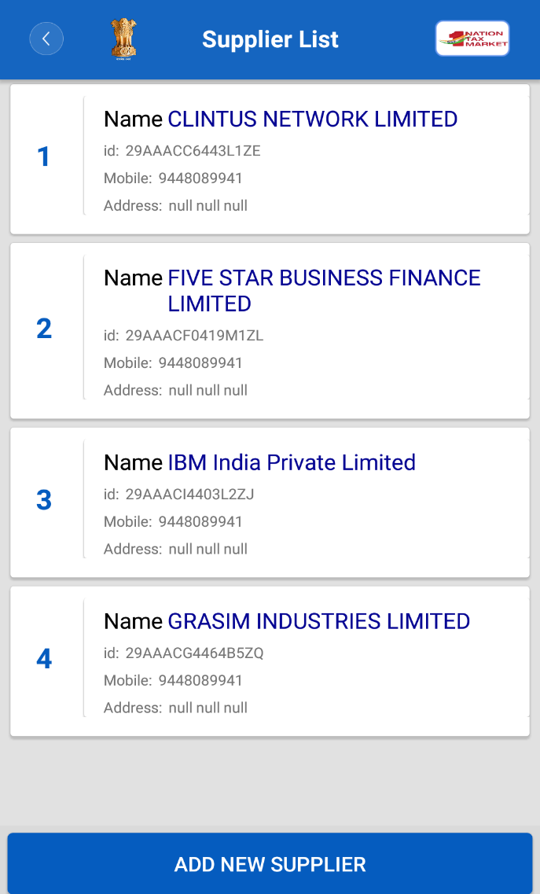
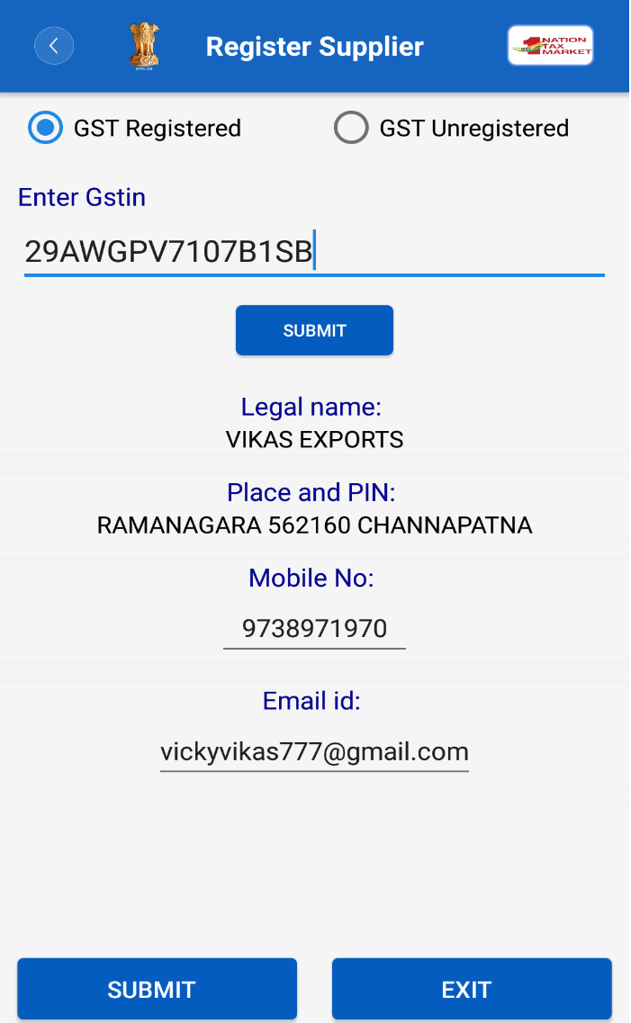
Adding My SUPPLIERs

Slide 48
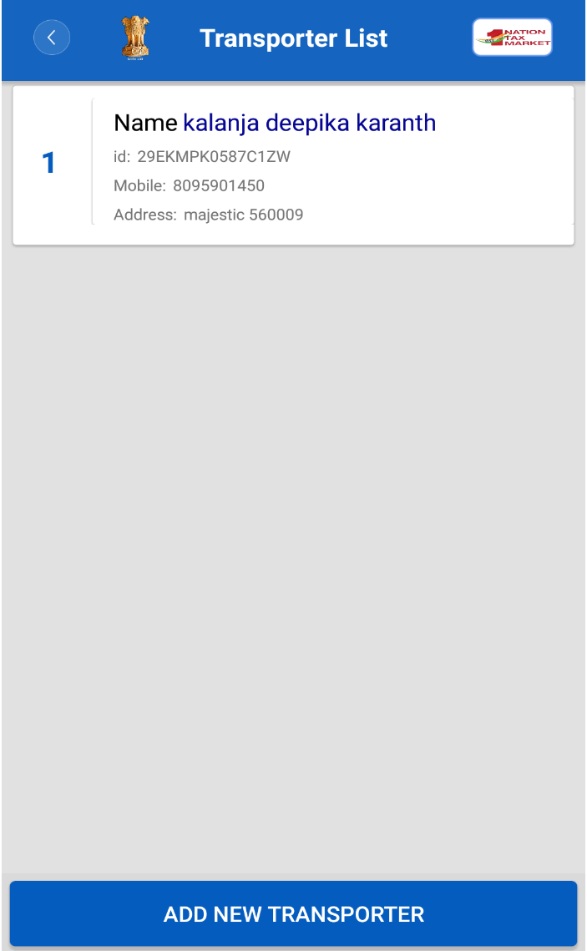
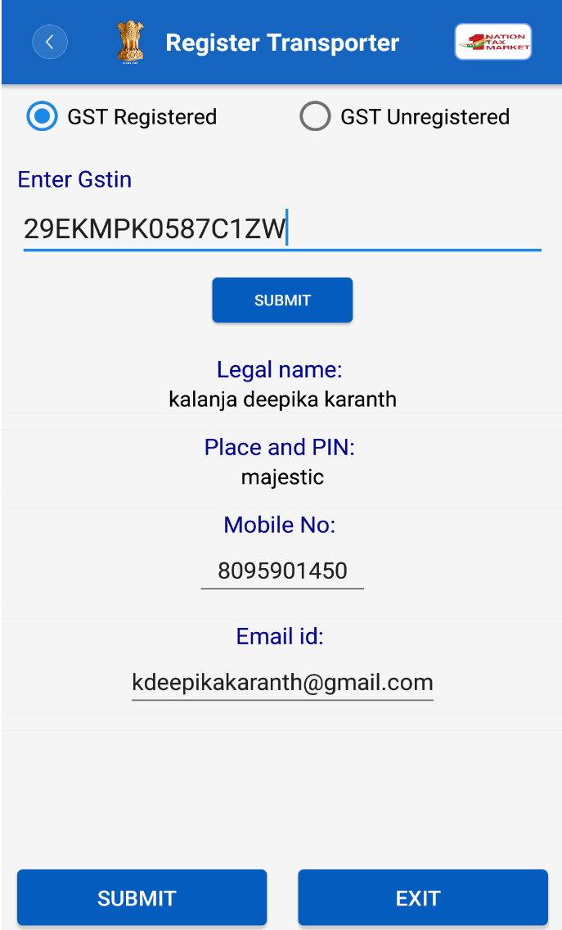
Adding My TRANSPORTERs

Slide 49
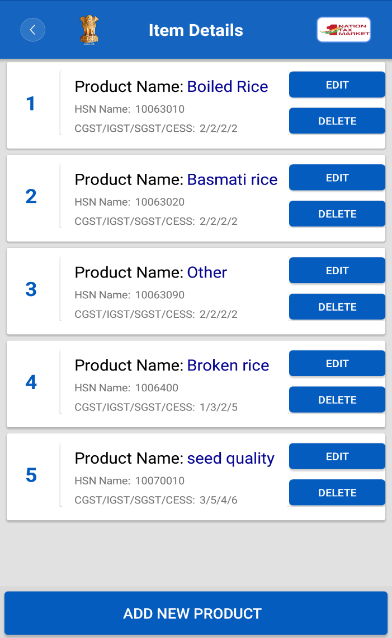
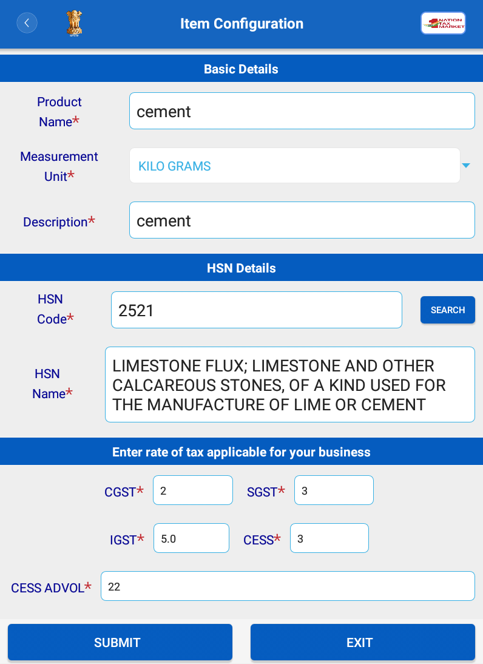
Adding My PRODUCTs

Slide 50
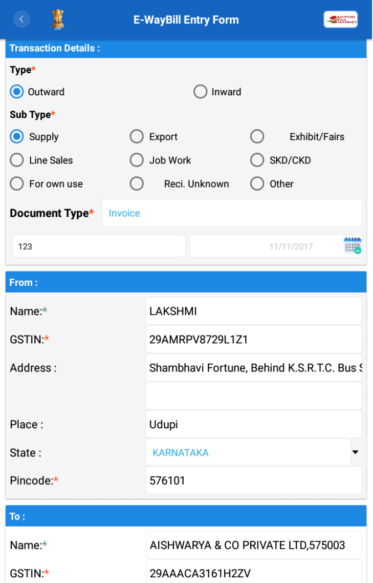
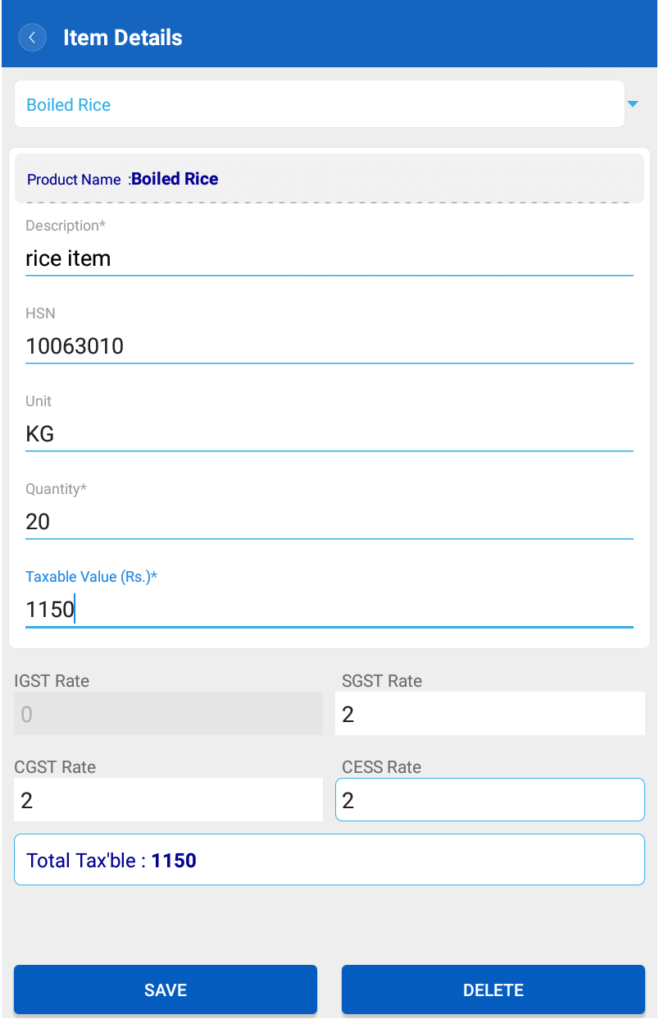
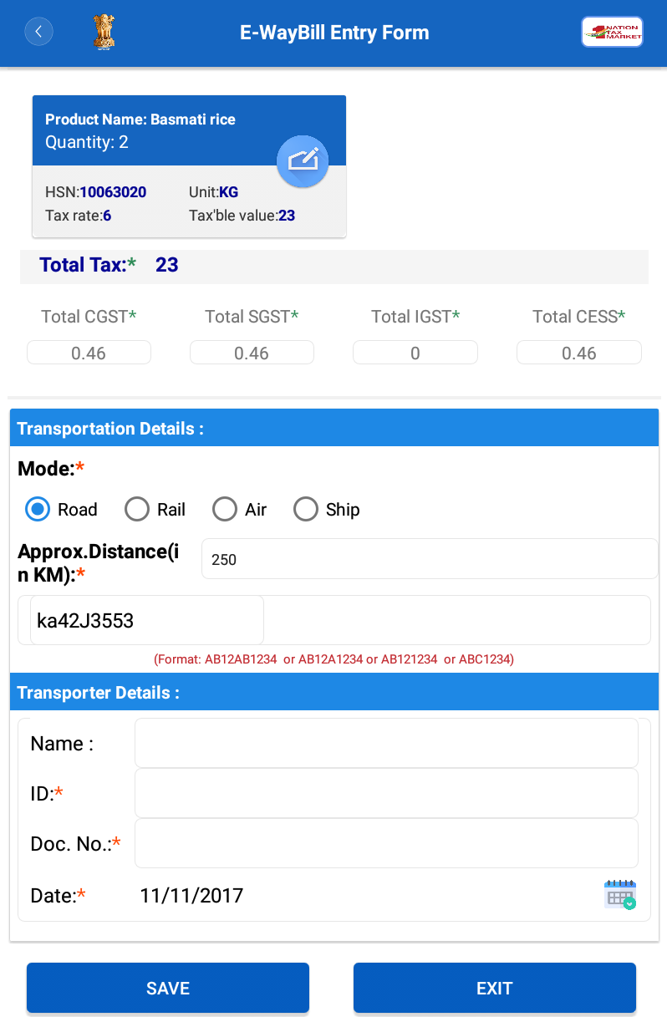
E-Way Bill Entry Form

Slide 51
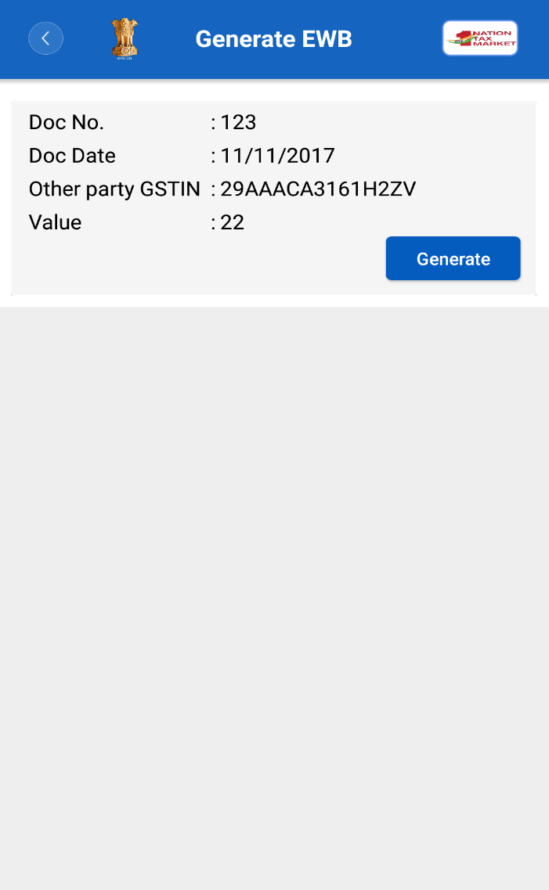
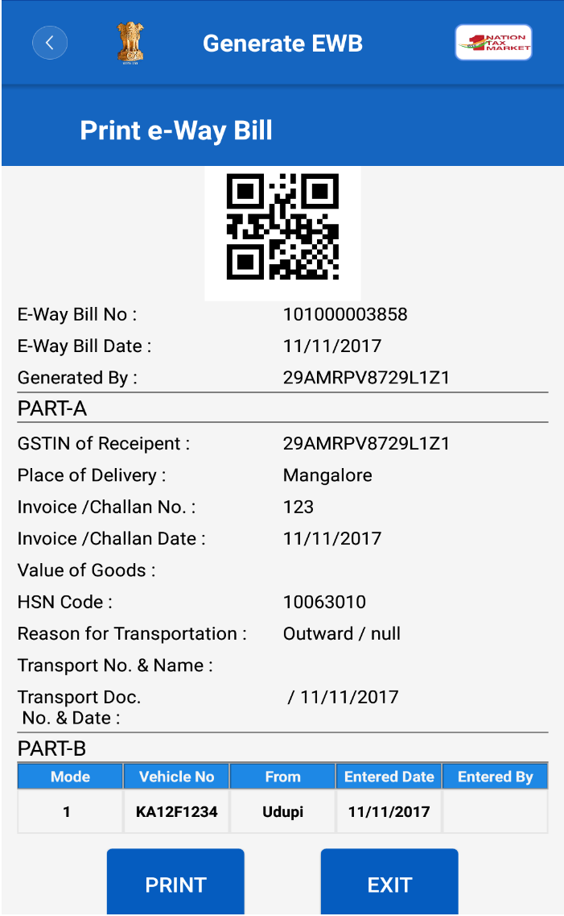
E-Way Bill Generate Form

Slide 52
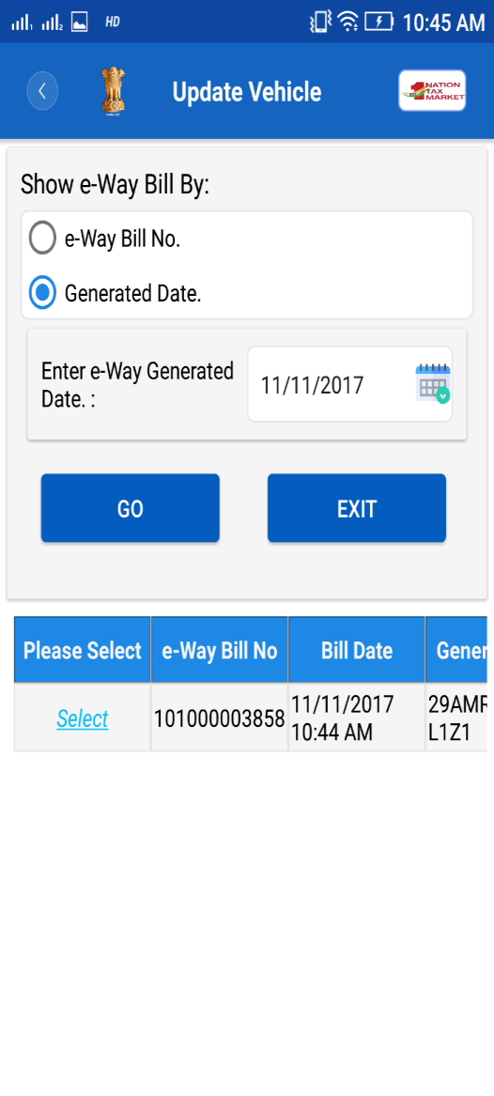
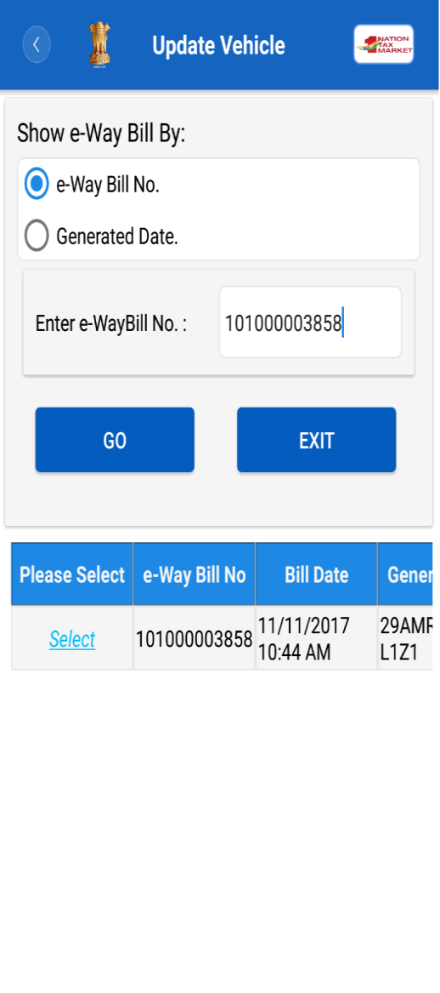
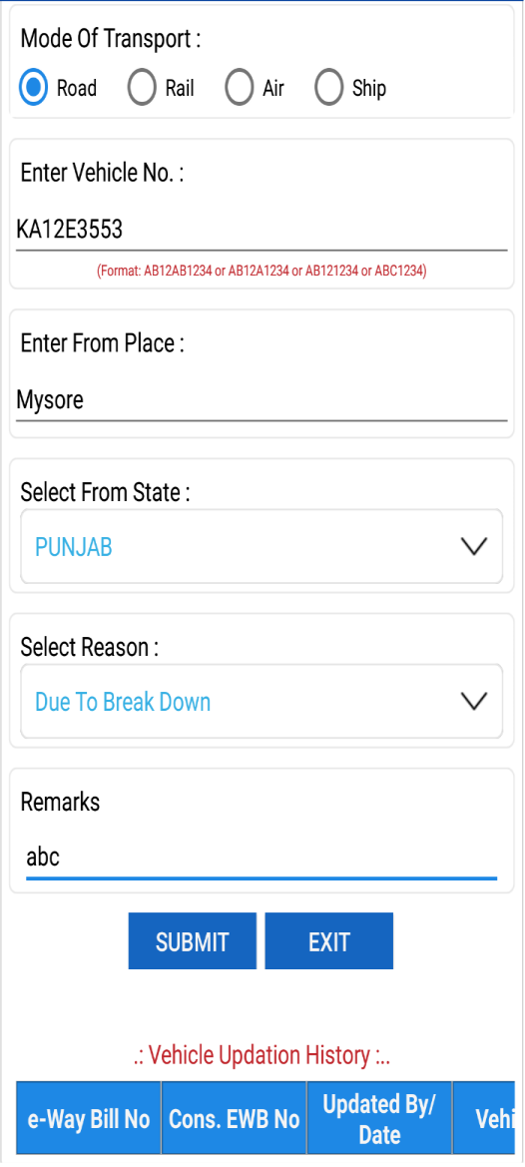
Updating Vehicle Number

Slide 53
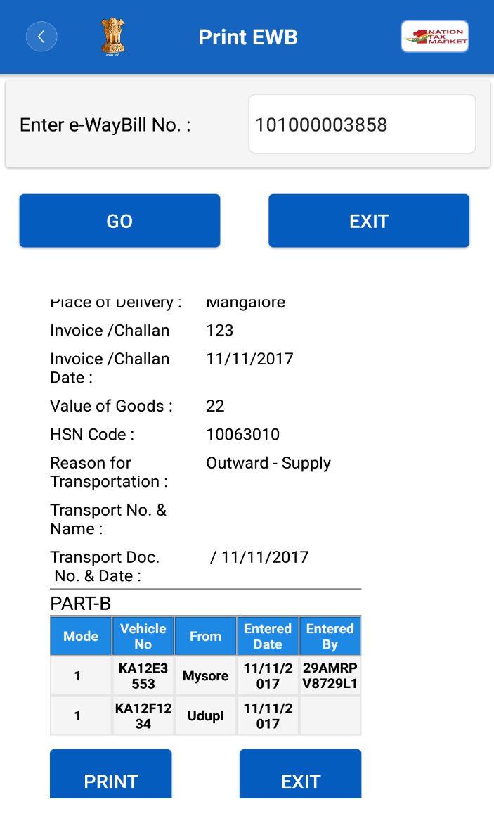
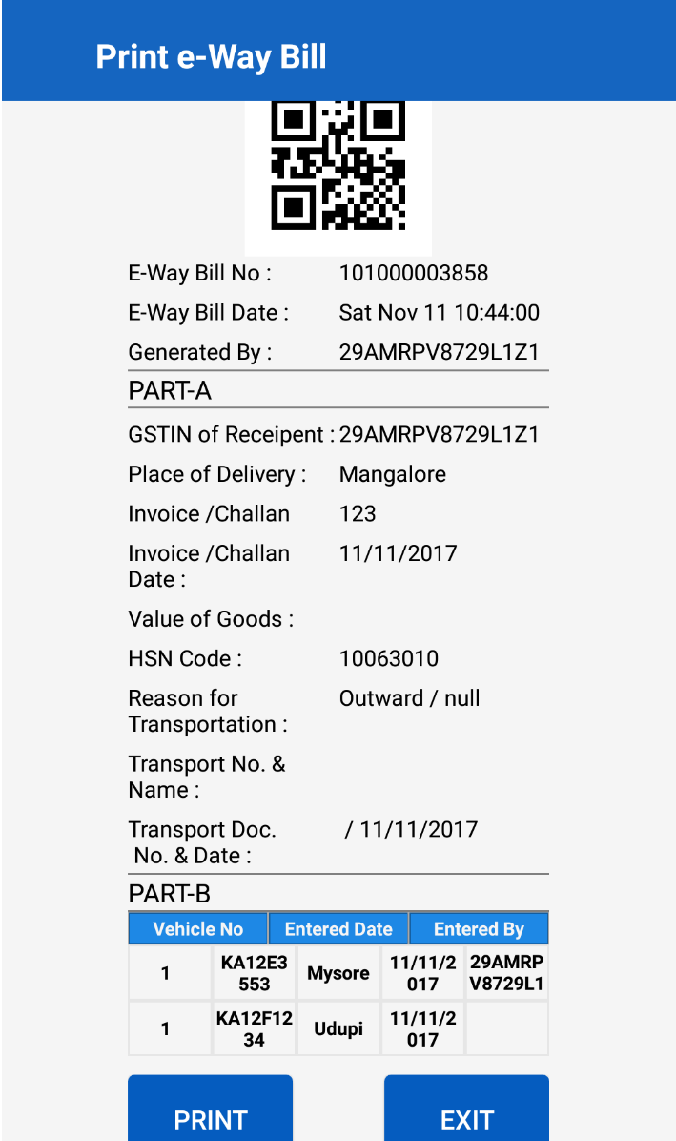
Printing EWB

Slide 54
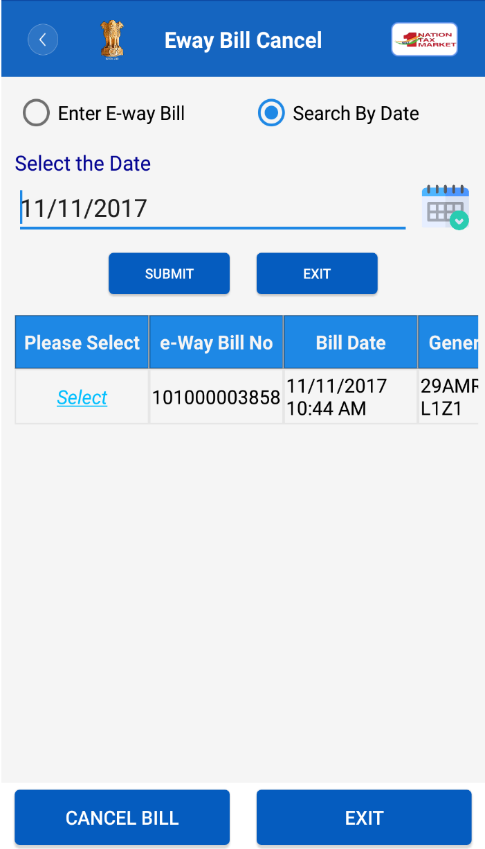
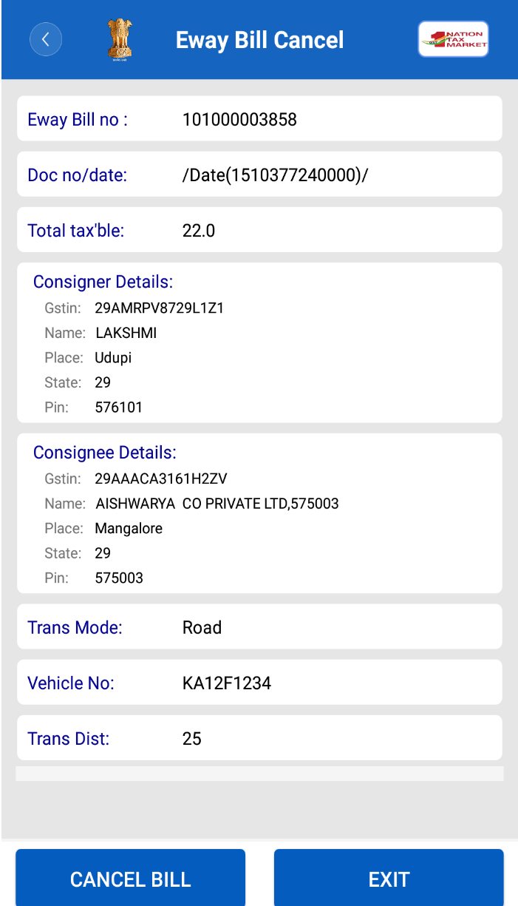
Canceling EWB

Slide 55
E-WAY BILL SYSTEM
API Interface

Slide 56
Application program interface (API) based EWB Generation
This is site-to-site integration of Tax payer system with EWB system
All the activities of e-way bill can be done on the API system
This can be used by tax payers who generates more than 200-300 EWB/day
APIs are RESTful Web service based with JSON(JavaScript Object Notation) format is a lightweight data-interchange format
The pre-requisite is Tax Payer systems should have SSL and Static IP
Tax Payer should test on the sandbox before going for production
Same APIs can be used by Suvidha Provider, if the Tax Payer has authorised him.

Slide 57
API Interface
Tax Payer
API System
E-way bill
API System
Request
Response

Slide 58
Benefits of API Interface
No need of double or duplicate entry – one for Invoice generation and other for E-Way Bill
Mistakes are avoided
No need of one more print – Invoice can have EWB No
EWB No. can be updated in Tax payer system with related invoice
E-way Bill data to GST System for GSTR-1
Readiness for Form INV - 1 (Invoice Reference Number)
Same API interface can be used in other states with requesting for those GSTIN

Slide 59
Example - API Interface for Tax Payer system
1
Tax payer enters invoice details in his system
2
Tax payer generated Invoice from his system
3
Tax payer system calls EWB system through API with relevant information
4
EWB system after authentication and verification of information, generates EWB and returns EWB No.
5
Tax payer system gets this EWB No. and writes to his database along with EWB No. on the Invoice Copy and moves the goods.

Slide 60
Example - API Interface for Transporter system
1
On hourly basis , TRANS system pulls all the ewaybills assigned to him from EWB system
2
Before movement of goods, transporter enters vehicle no. for his LR and saves in his system
3
4
EWB system after authentication and verification of details , updates vehicle details and gives ACK.
Now, TRANS system calls EWB system with EWB No. and other details requesting to update Part B.
5
TRANS system updates this ACK and prints the Tripsheet.
Now, transporter moves the goods.

Slide 61
E-WAY BILL SYSTEM -
RFID Interface
BY

Slide 62
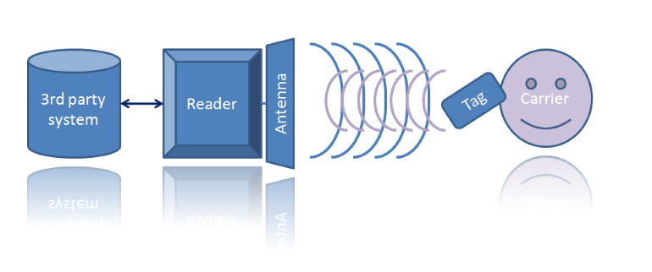
How it works

Slide 63
What is RFID
Radio-frequency identification (RFID) uses electromagnetic fields / waves to automatically identify and track tags attached to objects.
It is contactless reading method
RFID System will have Tags and Readers
Tags – an integrated circuit for storing and processing information.
Tags are attached to the objects to be identified
Readers - Readers transmit interrogator signals and also receive authentication replies from tags.

Slide 64
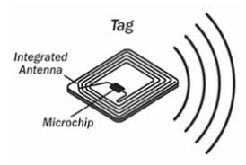
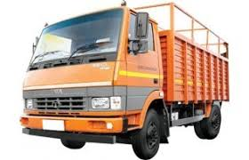
RFID Tags
Vehicle with RFID tag

Slide 65
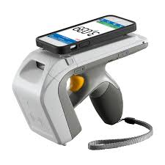
RFID in EWB System
Web
EWB System
RFID Reader on Road
RFID Mobile Reader with Officer
Vehicle with RFID tag

Slide 66
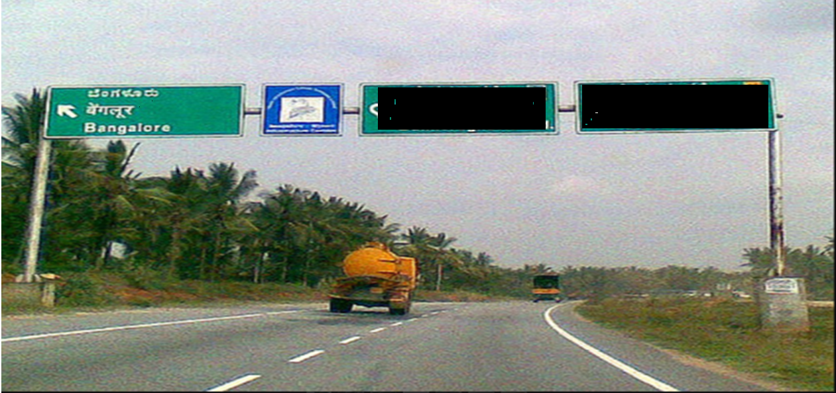
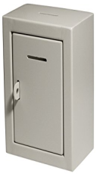
Pilot RFID at Bangalore
39.1 feet
Antenna
BOX

Slide 67
Way Forward
Pilot project is going on at one of the place at Bangalore
Implementation needs more time as lot of activities have to take place like
Making compulsory RFID for Vehicle
Linking RFID tag during Vehicle registration
Establishing RFID readers at different places

Slide 68
THANK YOU

